Slide 1
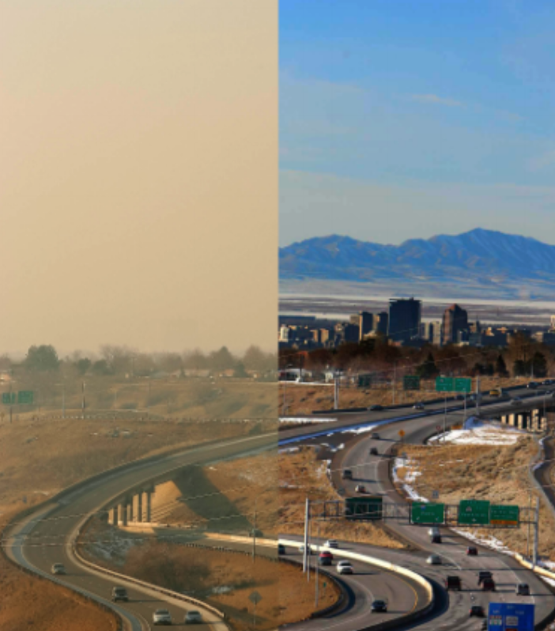


Air Quality and U: Improving Air Quality Monitoring in SLC
Dylan Wootton

Slide 2
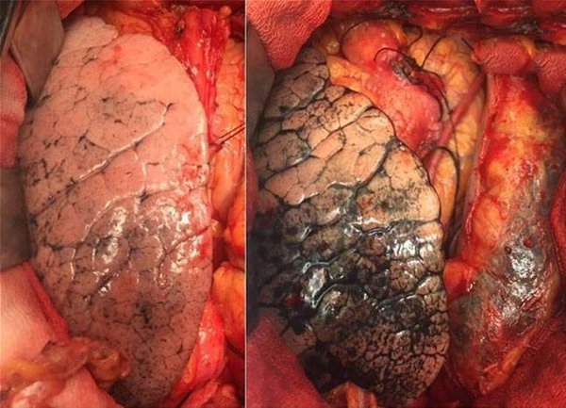
Poor Air Quality Causes Irreversible Damage to Cardiac and Respiratory Health.¹
50 years of clean air (rural)
50 years of air pollution (city)
Poor air quality leads to 2,000 premature deaths of Utah residents each year.²
[1] - Yu-Fei Xing. Thoracic Disease. January 2016. Pg 69 – 74.
[2] - Brian Moench. Salt Lake Tribute. Jan 24th 2013. Full Article.
Notes:
Super scripts (Possibly cleaner). On the slide have the first author the abbr journal, the volume, year, and page number. [no title, just the date]/
Cite the images.

Slide 3
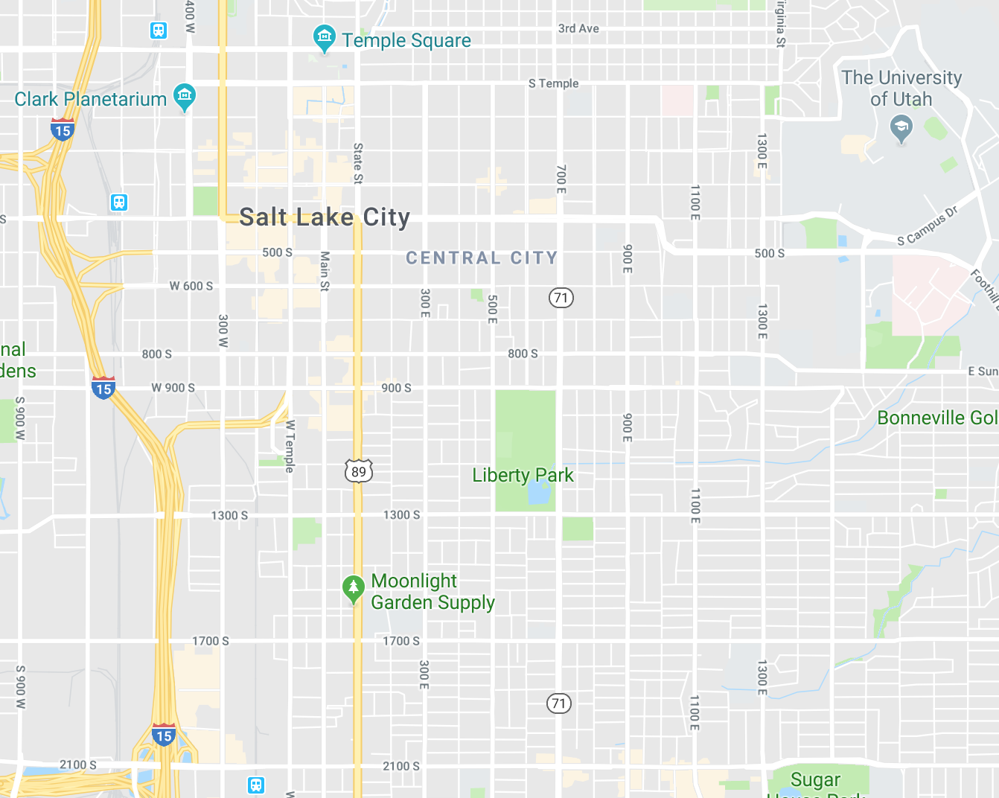

BAD

Slide 4
BAD
REAL
BAD
We lack the data to make informed decisions about air quality.
BAD
LESS
BAD
MORE
BAD
The severity of air pollution can vary significantly, even between distances of 50 meters.³
[3] S. Steinle. Total Environment. Jan 2013. 183-193

Slide 5
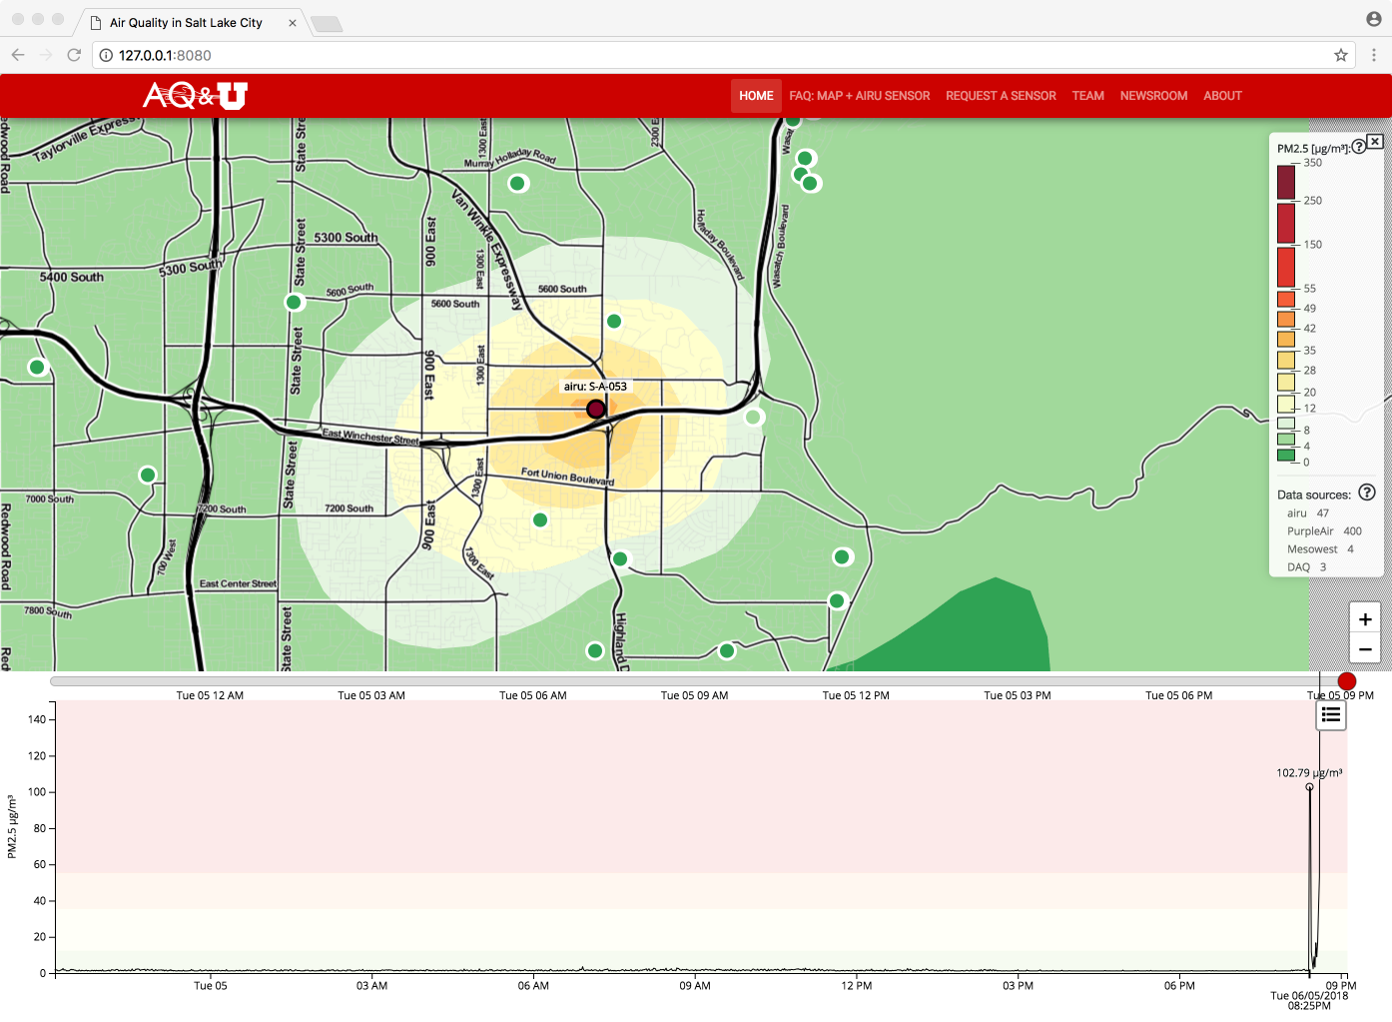
We strategically placed sensors and use a model to interpolate between them.
Notes:
Make the model picture bigger. Look into changing the legend into a larger legend. Make the spike a separate slide (where it fills it).

Slide 6
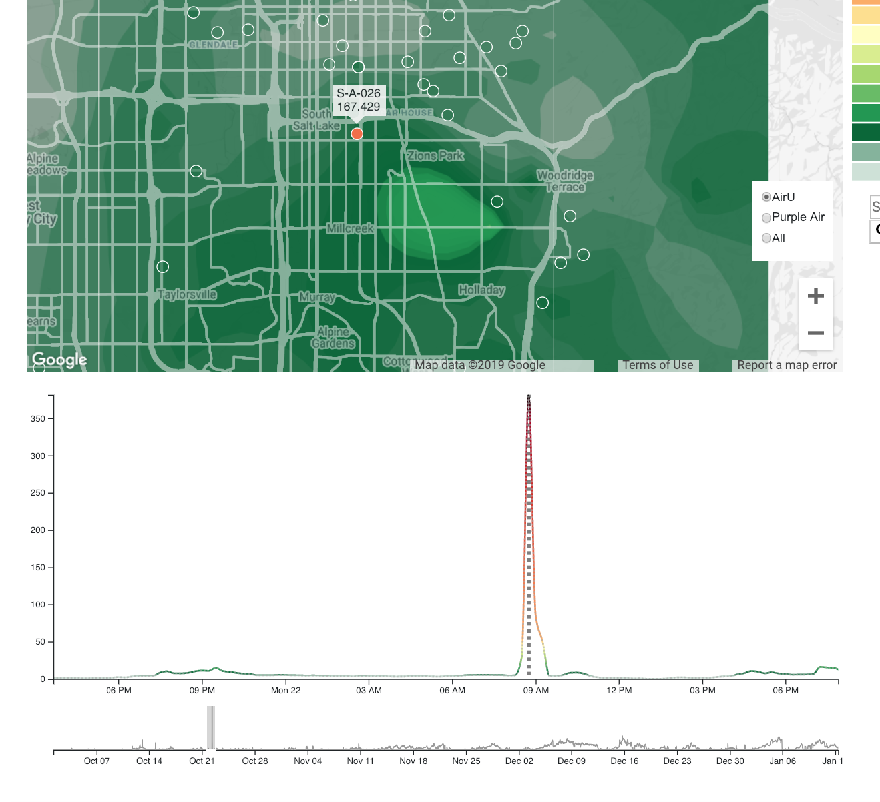
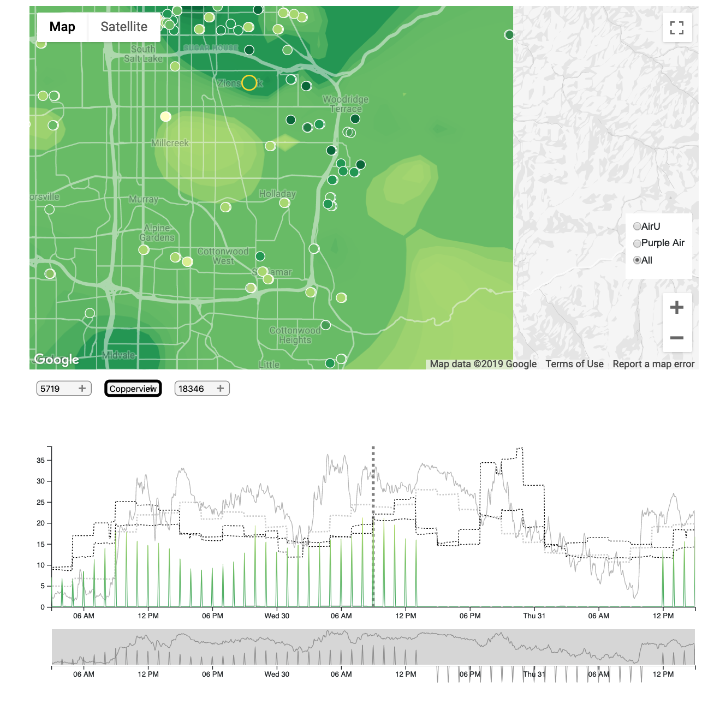
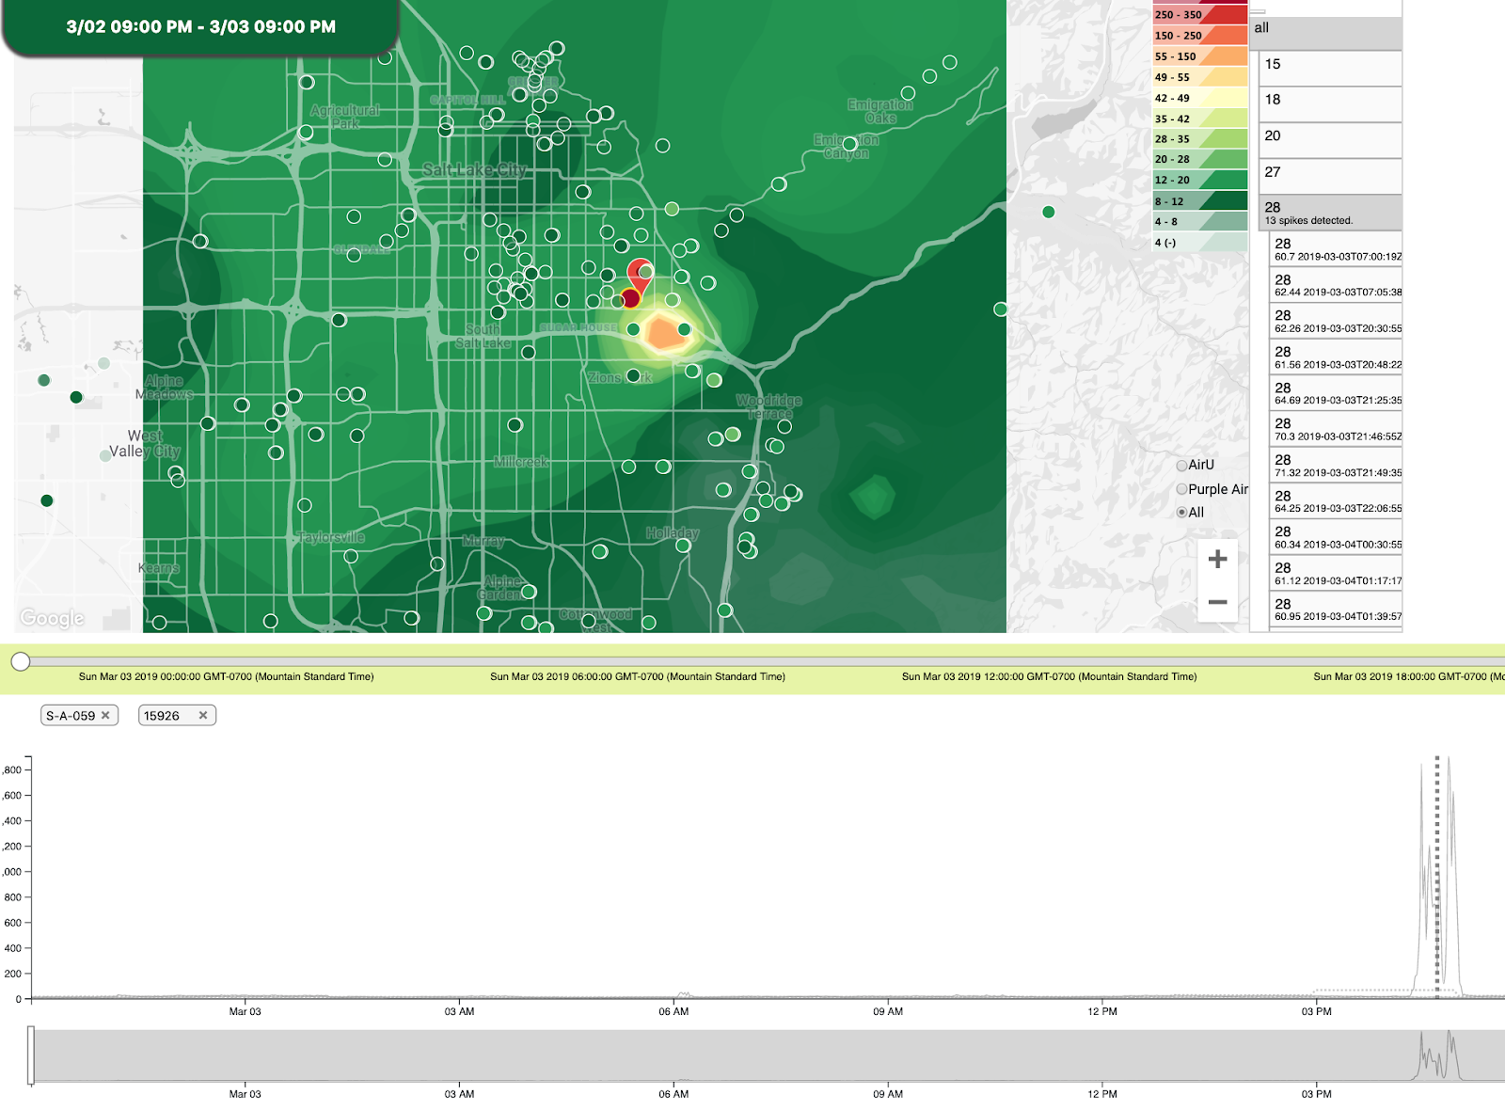
I developed software to allow a user to explore these spikes in air pollution

Slide 7
Using the knowledge we gained, we built a classifier to determine if a sensor reading would skew the model.

Slide 8
This classifier works through mini ‘flow charts’ known as Decision Trees.

Slide 9
Multiple Decision Trees form a ‘Forest’
Disrupt
Disrupt
No Disrupt

Slide 10
We use 100’s of these trees and use the ‘decision of the forest’

Slide 11
Better data means better outcomes.

